Slide 1
Implementation of an Othello Player
Sara Gholami,
Sara Ghaemi

Slide 2
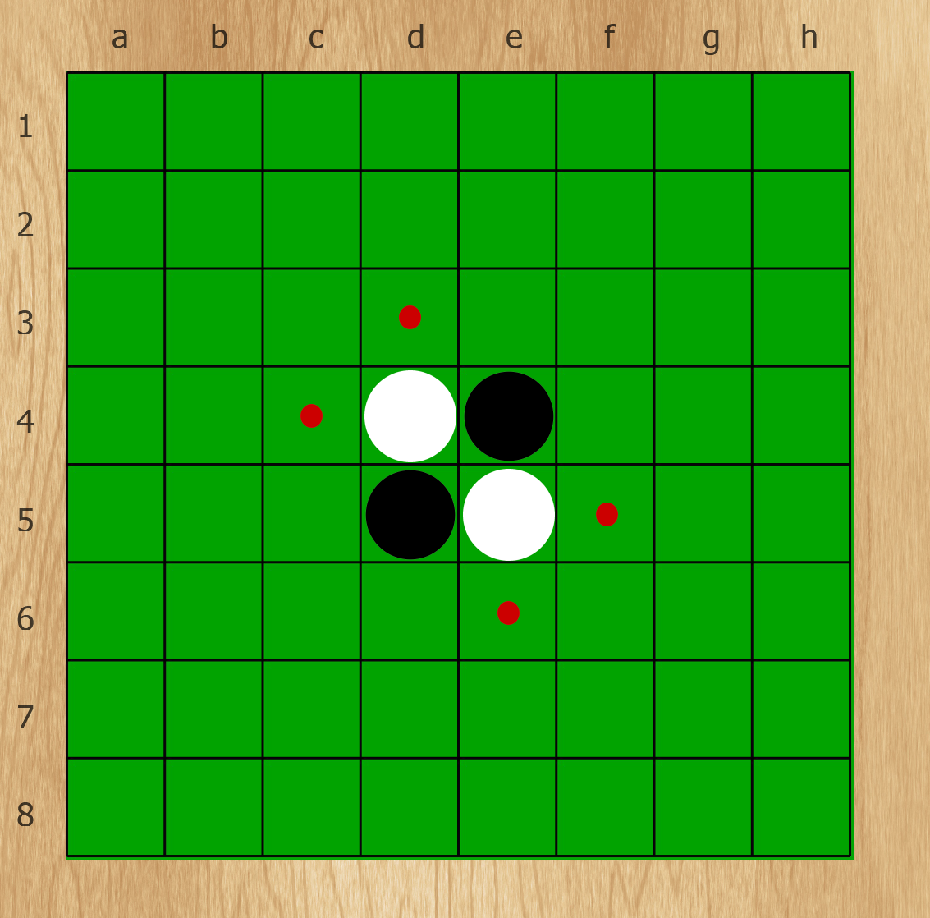
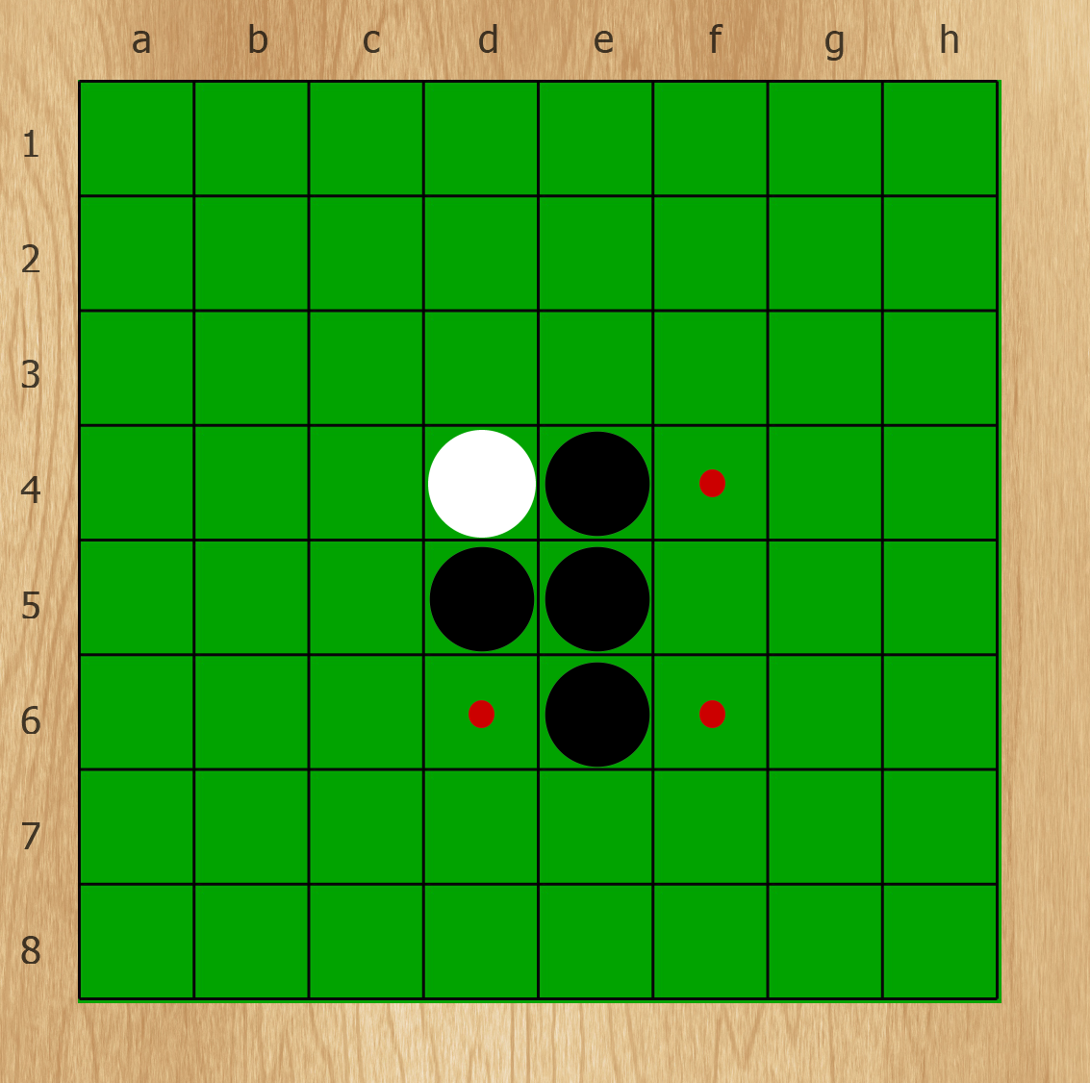
What is Othello
Also called Reversi
Two player game
Black goes first

Slide 3
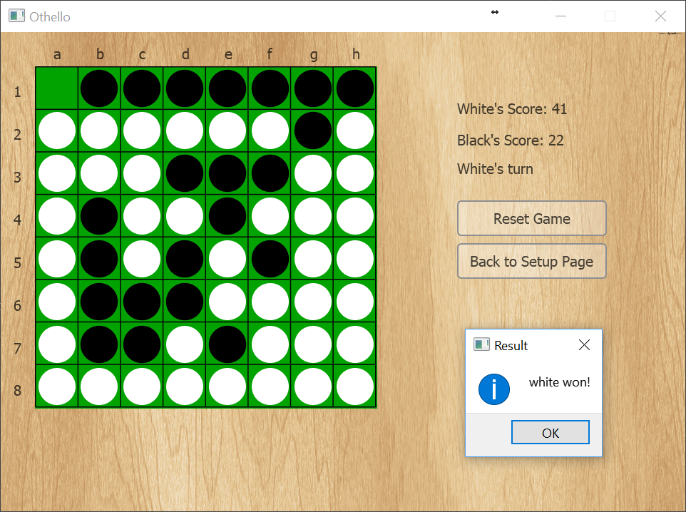
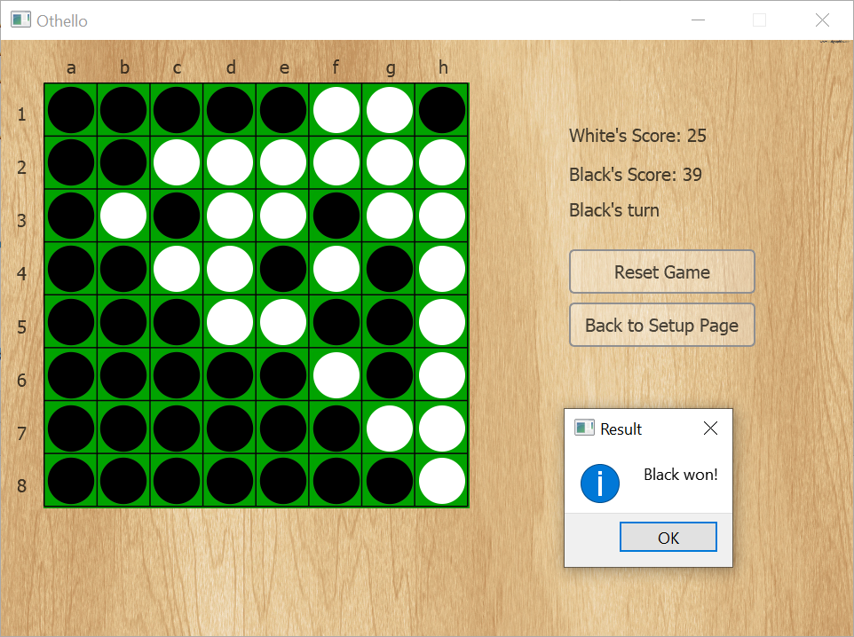
Terminating Condition
The board is full
No one has any move

Slide 4
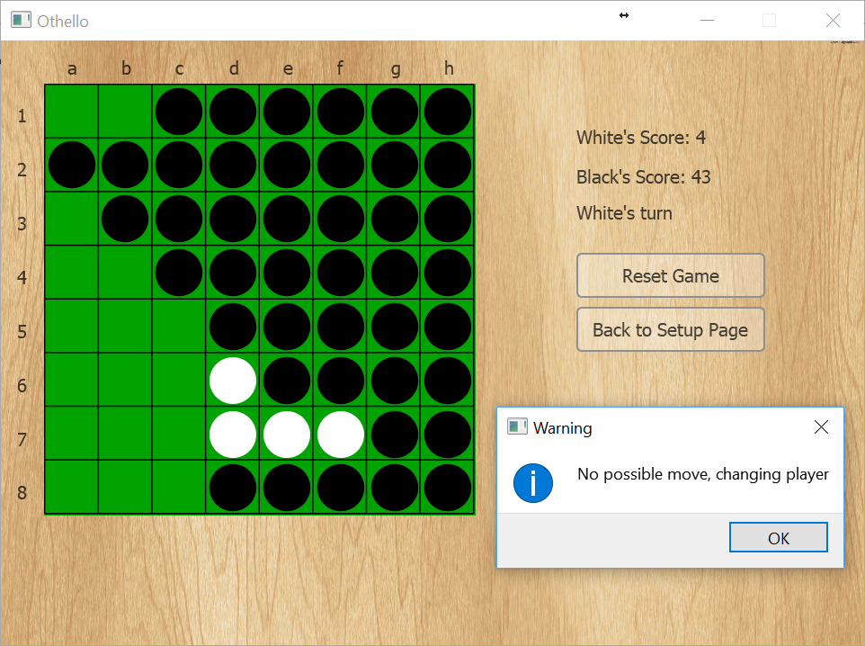
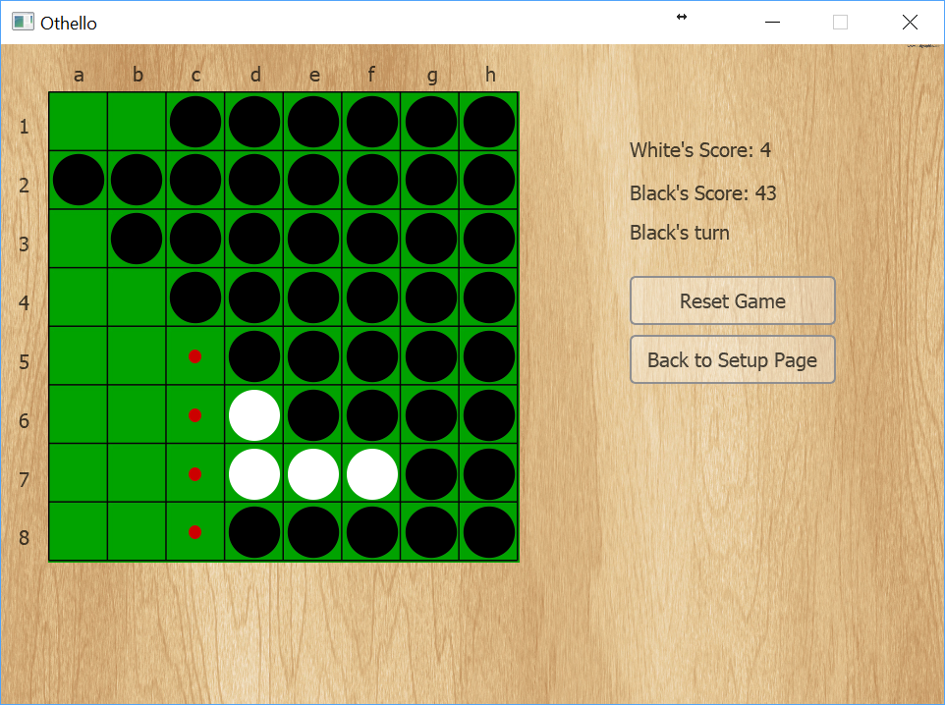
Special Case
When you do not have any move!
You loose your turn!

Slide 5
Winner
Count number of stones of each player
Player with higher number wins

Slide 6

Our Approach

Slide 7
Heuristic Player
Coin Parity
Static Weighting
Mobility
Potential Mobility
Corners
Stability

Slide 8
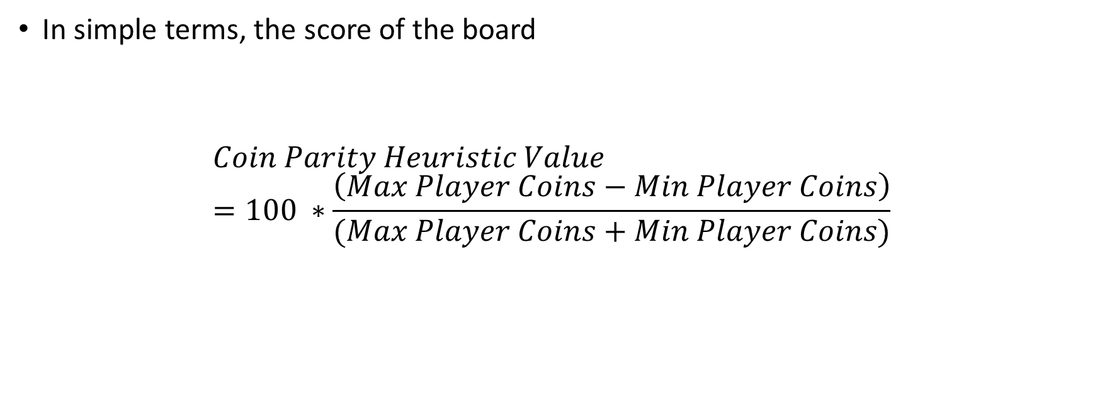
Heuristics - Coin Parity
In simple terms, the score of the board
$$Coin Parity Heuristic Value=100 ∗\frac{\left(Max Player Coins−Min Player Coins\right)}{(Max Player Coins+Min Player Coins)}$$

Slide 9
Heuristics - Mobility
The number of next moves a player has, given the current state of the game.

Slide 10
Heuristics - Potential Mobility
The number of empty spaces next to at least one of the opponent’s coin

Slide 11
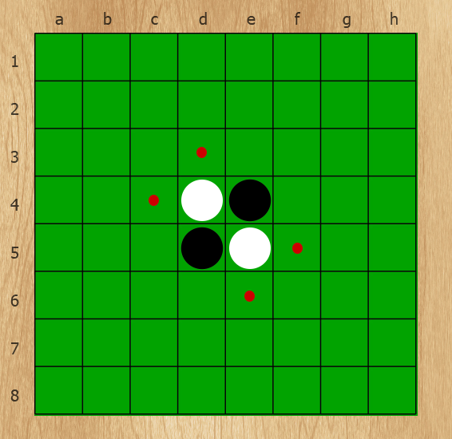
Heuristics - Corners
Once captured cannot be flanked

Slide 12
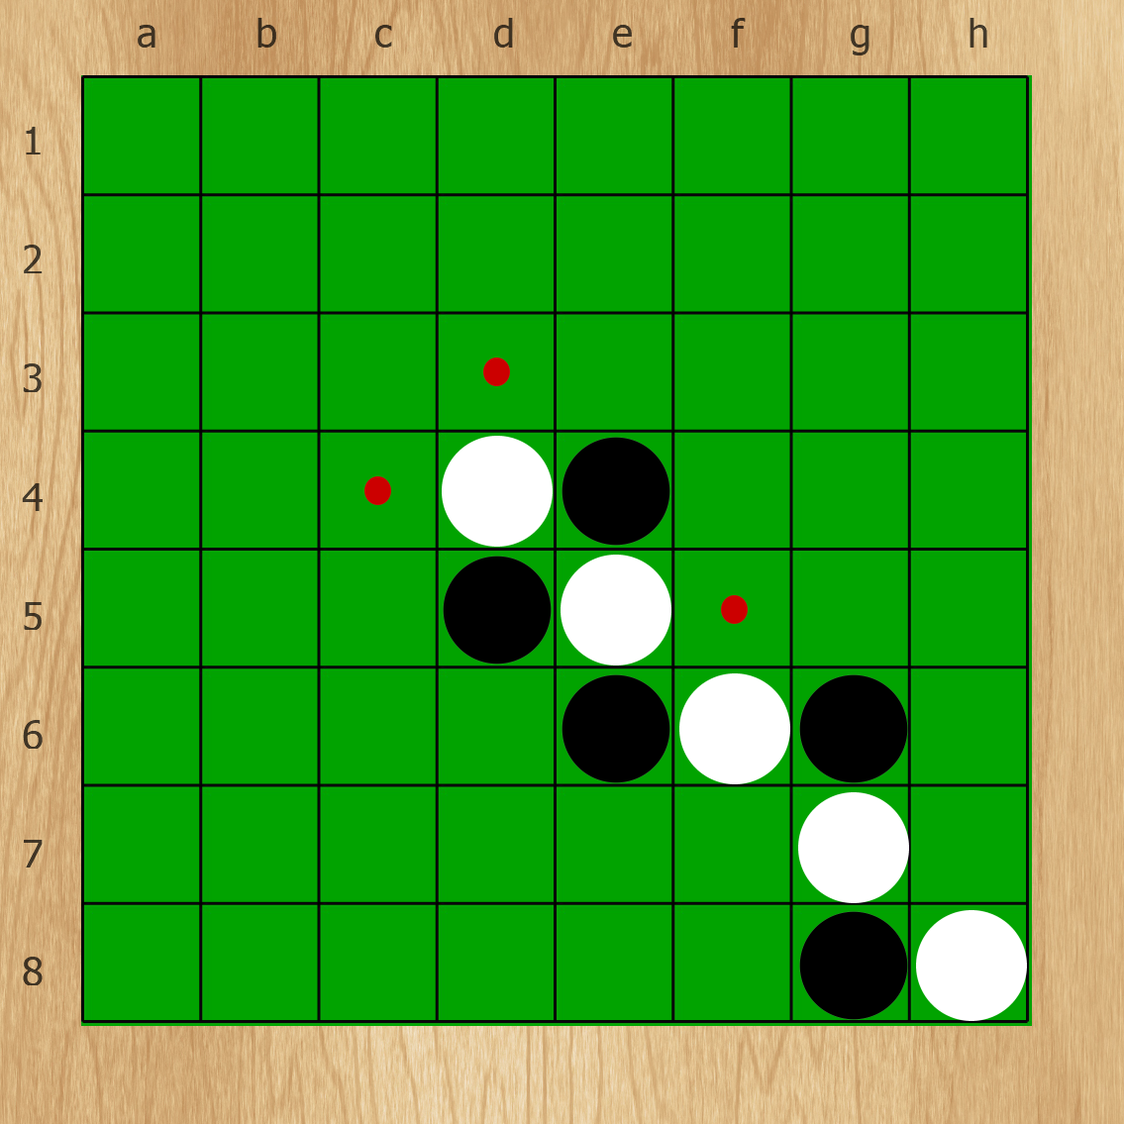
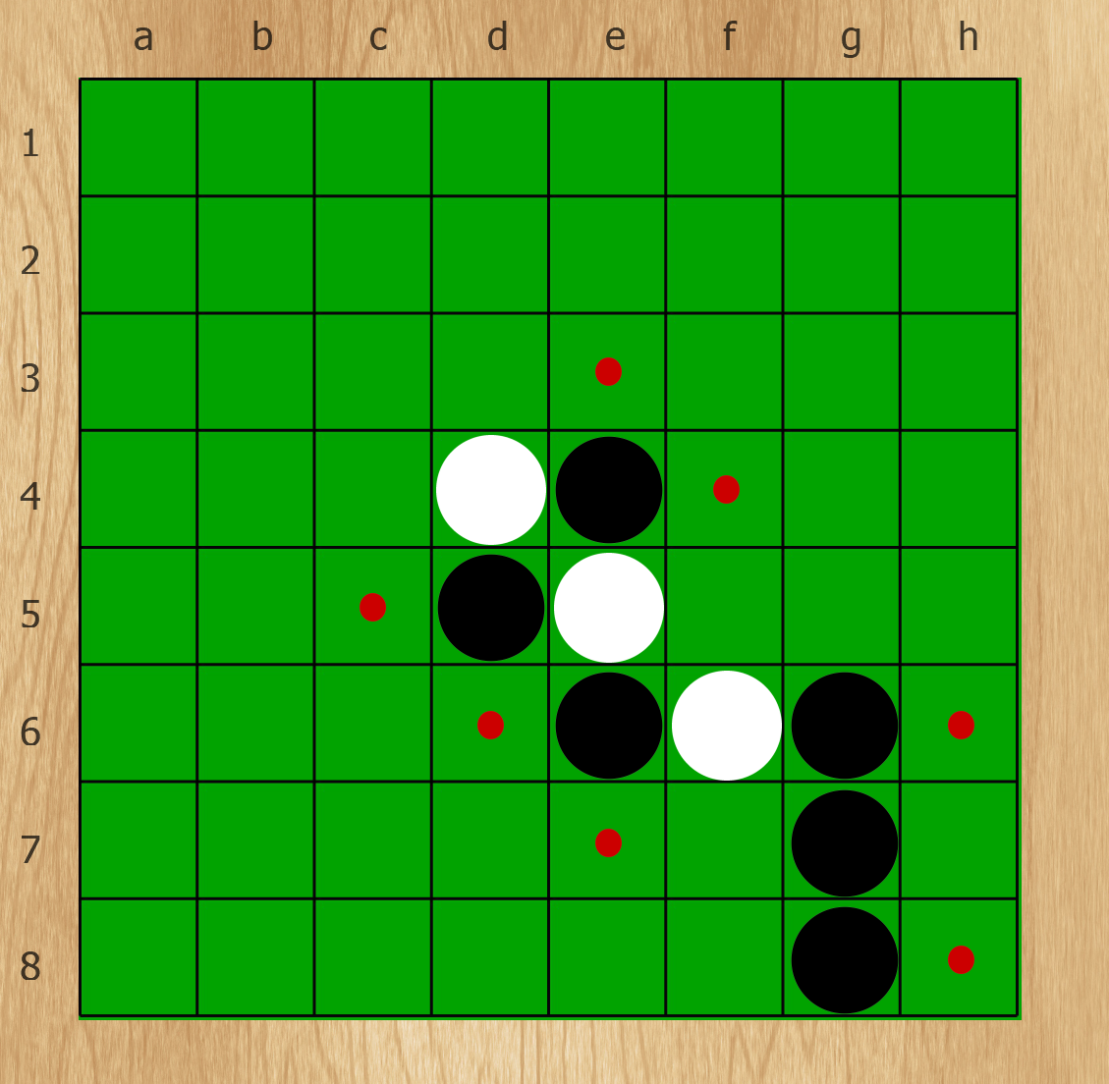
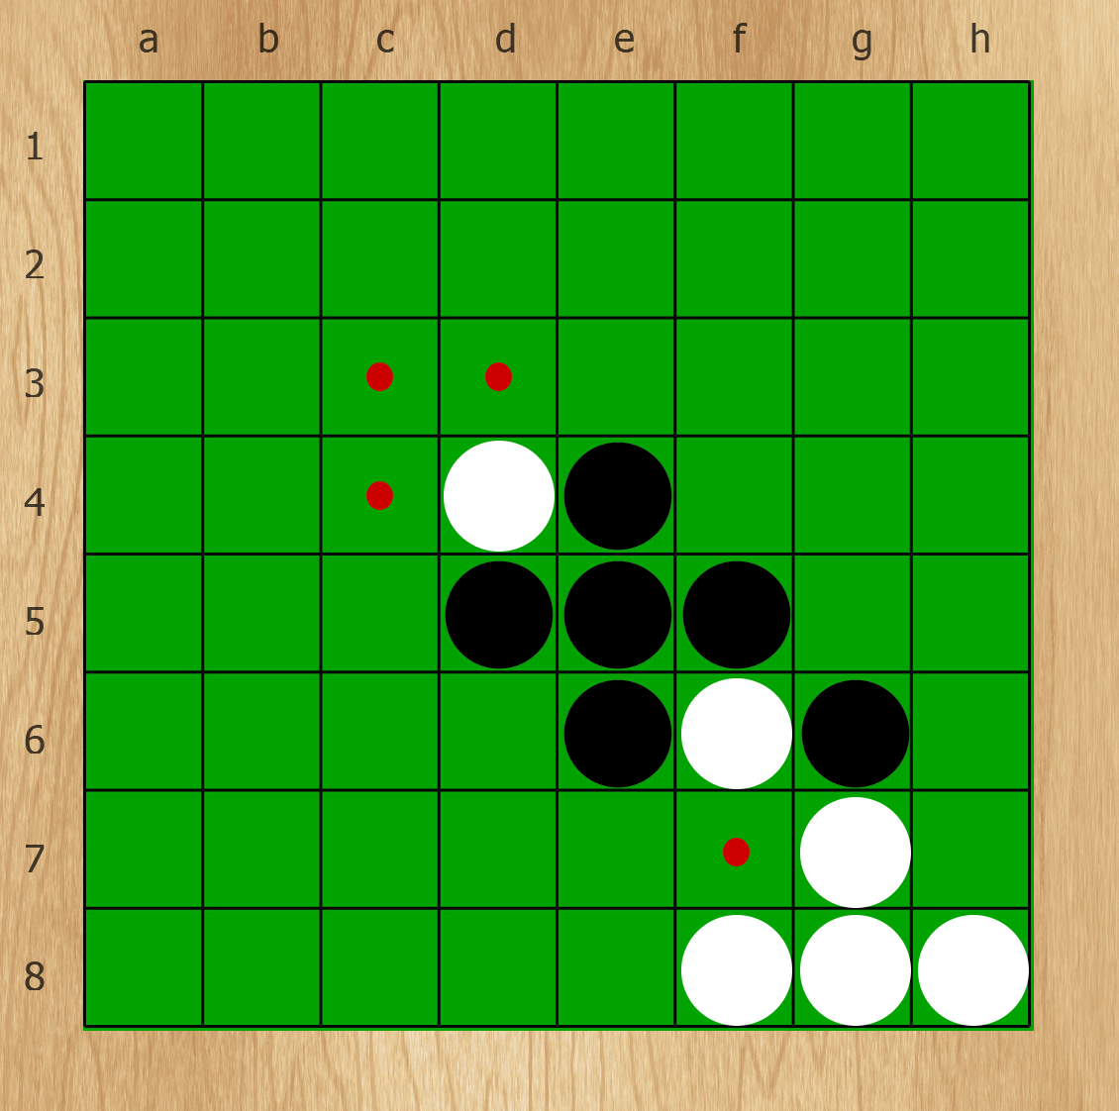
Heuristics - Stability
Start by capturing corners squares
Then build stables stones upon them

Slide 13
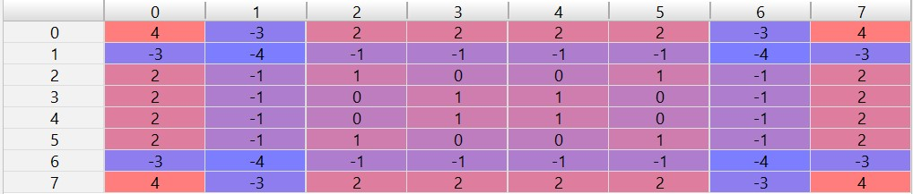
Heuristics – Static Weighting
Adding together weights of the squares in which the player’s coins are present

Slide 14

Combining Heuristics
Combine the heuristics result with a linear combination
$$mobility+ potential_mobility+ coin_parity+ 2 ∗ static_weight+8 ∗ stability+8 ∗ corners$$

Slide 15
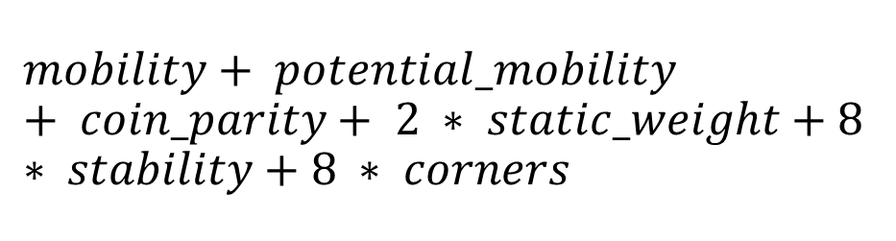
Example
White Potential Mobility: 9
Black Potential Mobility: 11
White Stability: 1
Black Stability: 0
White Static Weight: 3
Black Static Weight : -2
White Mobility: 8
Black Mobility: 3
White Corner: 1
Black Corner: 0
White Stones: 5
Black Stones: 5
Coin parity
Mobility
Potential Mobility
Corners
Stability
Static Weight
1
1
1
-4
$$mobility+ potential_mobility+ coin_parity+ 2 ∗ static_weight+8 ∗ stability+8 ∗ corners$$
4

Slide 16
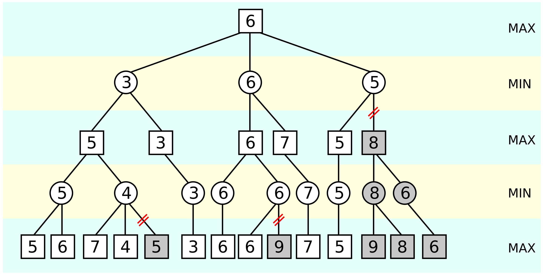
Alpha-beta Pruning

Slide 17
Alpha-beta Pruning in Our Player
Player | Depth
Beginner | 1
Intermediate | 2
Hard | 3

Slide 18

GitHub
https://github.com/SaraGhlm/Othello

